Slide 1
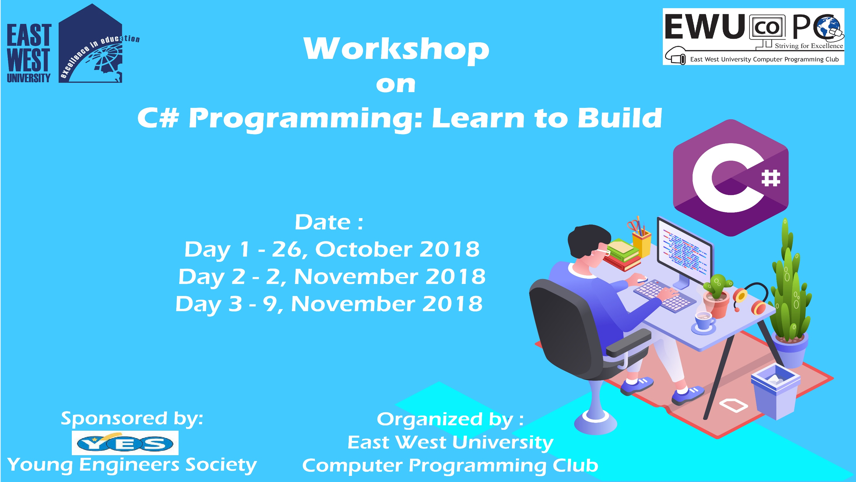

Slide 2
C# Day 2 Lecture7: Loops

Slide 3
Loops
for(init; condition; increment)
{
statement;
}

Slide 4
Loops
for(int i = 5; i<= 10; i++)
{
Console.WriteLine("Value of a is: {0}", i);
}
Console.ReadLine();

Slide 5
Loops
while(condition)
{
statement;
}

Slide 6
Loops
int i = 10;
while(i<20){
Console.WriteLine("Value of i: {0} ", i);
i++;
}
Console.ReadLine();

Slide 7
Loops
do {
statement;
}
while(condition);

Slide 8
Loops
int i = 10;
do{
Console.WriteLine("Value of i: {0}", i);
i++;
}
while(i<20);
Console.ReadLine();

Slide 9
Loops
foreach(type element in iterable-item)
{
statement;
}

Slide 10
Loops
char[] array = {'B', 'a', 'n', 'g', 'l', 'a', 'd', 'e', 's', 'h'};
Foreach(char ch in array){
Console.WriteLine(ch);
}

Slide 11
This slide is provided as a course material in the workshop named “Workshop on C# Programming: Learn to Build”.
Organized by-
East West University Computer Programming Club (EWUCoPC)
Prepared by- Jannat Binta Alam
Campus Ambassador
Young Engineers Society (YES)
E-mail: jannat.cse.ewu@gmail.com

